Slide 1
RETAIL PERFORMANCE REVIEW 2022
A Data-Driven Analysis & Insights Report
INDIVIDUAL PROJECT BY
YEN HOANG - DA25

Slide 2
1
2
3
4
Introduction
Methodology
Analysis & Insights
Recommendations
Provides an overview of the report’s purpose and objectives.
Describes the process of data collection, ETL operations, and how the data was analyzed and visualized.
Examines financial performance and category sales alongside customer demographics and spending behaviors.
Provides recommendations based on sales and customer data to drive growth, improve performance, and optimize strategies.

Slide 3
1
As we enter 2023, this report serves as a comprehensive wrap-up of the Mall of Istanbul's retail performance for the year 2022. It offers an in-depth review of financial metrics and customer dynamics, providing crucial insights into the mall's performance over the past year.
This analysis is specifically designed to inform strategic decision-making and guide planning efforts for future growth, using the lessons learned from 2022 to shape a successful path forward in 2023.
Introduction

Slide 4
2
Data Collection:
Data was sourced from Kaggle as a CSV file, which included various retail performance metrics and customer information for Mall of Istanbul.
Data Processing:
ETL Process: The data underwent an Extract, Transform, Load (ETL) process using Python. This included importing, cleaning, and transforming the data to filter, remove inconsistencies and standardize formats before saving it into a new CSV file.
Data Analysis:
Dashboards: Interactive dashboards were created using the cleaned data. These dashboards focused on two main areas: sales and financial performance, and customer insights.
Visualization Tools:
Tableau: Used for building and visualizing dashboards to gain insights into the mall’s financial performance and customer behavior.
Methodology

Slide 5
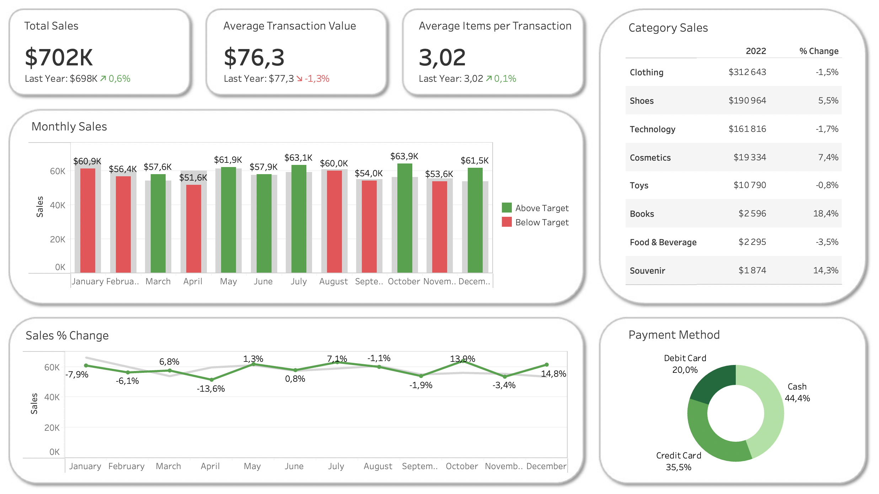
SALES & FINANCIAL DASHBOARD
3
Analysis & Insights
Financial Performance Overview:
Total Revenue: $702,000
ATV: $76.30
AIT: 3.02
Monthly Revenue Performance:
Above Target: March, May, June, July, October, and December
Below target: January, February, April, August, September, and November.
Sales by Category:
Top Categories: Clothing, Shoes, and Technology.
Bottom Categories: Souvenirs, Food & Beverage, and Books.
Payment Methods Distribution:
Cash: 44.4%
Credit Card: 35.5%
Debit Card: 20%
*Notes
Notes:
In 2022, the Mall of Istanbul achieved $702K in total sales, a 0.6% increase from last year, demonstrating resilience in a challenging economic environment. The average transaction value slightly decreased by 1.3% to $76.3, suggesting stable transaction numbers but reduced spending per visit, possibly due to inflation or changing consumer behavior. The average items per transaction remained steady at 3.02, indicating consistent purchasing patterns.
Monthly sales showed significant fluctuations, with May, July, and December surpassing targets, while several months underperformed. Seasonal trends and promotions heavily influenced these variations, highlighting opportunities to smooth out sales throughout the year.
Category performance varied, with Books (+18.4%), Souvenir (+14.3%), and Cosmetics (+7.4%) leading growth, while Food & Beverage (-3.5%), Technology (-1.7%), and Clothing (-1.5%) underperformed. This shift suggests evolving customer preferences.
Payment methods were dominated by cash (44.4%), followed by credit cards (35.5%) and debit cards (20.0%), underscoring the need for robust digital payment systems and potential to encourage more cashless transactions for better data capture and operational efficiency.

Slide 6
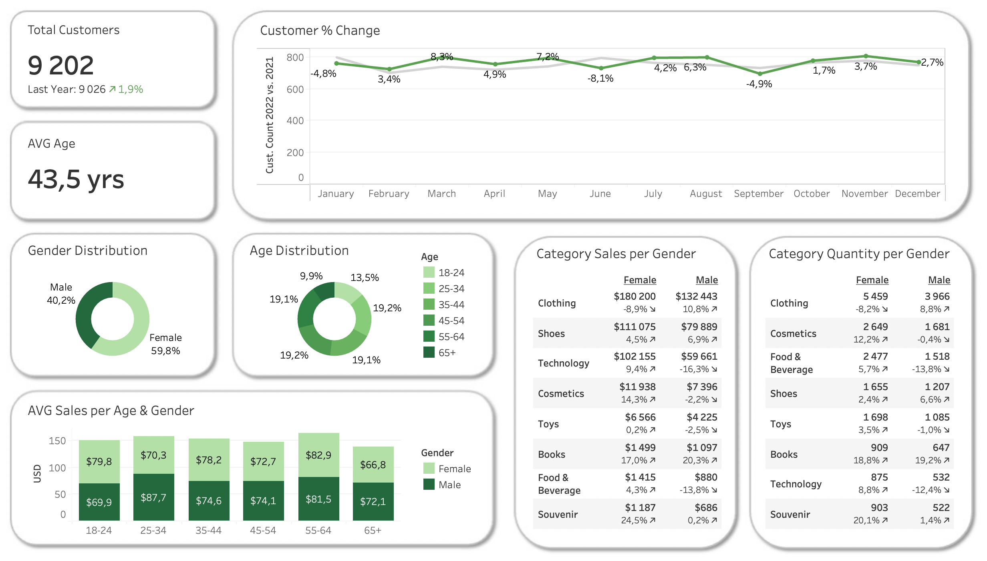
CUSTOMER INSIGHTS DASHBOARD
3
Analysis & Insights
Customer Overview:
Total Customers: 9202
Average Age: 43.5 years
Customer Percentage Change: Stable with minor declines.
Demographic Distribution:
Gender Distribution: 40.2% male vs. 59.8% female.
Age Distribution: Age groups between 25-64 (19.1-19.2%), 18-24 (13.5%), and 65+ (9.9%)
Spending Behavior:
Average Sales by Age and Gender: The highest average spend is in the 55-64 age bracket ($164.40). Generally, females spend more than males.
Category Sales by Gender: Top categories (Clothing, Shoes, Technology)
Category Quantity by Gender:
Top categories (Clothing, Cosmetics, Food & Beverage).
*Notes
Notes:
In 2022, Mall of Istanbul grew modestly, with total customers increasing by 1.9% to 9,202. Monthly performance fluctuated, with strong growth in March (+8.3%) and April (+7.2%), but declines in January (-4.8%) and September (-4.9%) indicate areas for improvement.
The customer base is predominantly female (59.8%) with an average age of 43.5 years. Age distribution is balanced across key segments: 19.2% are aged 35-44, another 19.2% are 45-54, 19.1% are 25-34, 19.1% are 55-64, 13.5% are 18-24, and 9.9% are 65+. These demographics highlight the need for tailored marketing strategies.
Average sales per age and gender show that customers aged 55-64 are the highest spenders, with females averaging $82.9 and males $81.5 per transaction. Younger males (25-34) also spend significantly, averaging $87.7 per transaction.
Clothing remains the top sales category, despite an 8.9% decline in female sales. Male clothing sales grew by 10.8%, and both genders showed increased interest in shoes and technology. Cosmetics and souvenirs saw substantial growth among female customers, up 14.3% and 20.1%, respectively.
Key Insight: Addressing the decline in female clothing sales and leveraging the spending power of key age groups, particularly 55-64, will be essential for growth in 2023.

Slide 7
Enhance Female-Centric Offerings: Female shoppers represent a significant portion of the customer base and tend to spend more. Expanding relevant stores and products, coupled with loyalty programs, can drive higher traffic and sales.
Engage Younger Audiences: Youth are a growing demographic with potential for increased spending, especially in technology. Targeted events and promotions can boost their engagement and spending, addressing underperforming categories.
Target High-Spending Older Adults: The 55-64 age group has the highest average spend. Offering premium and health-focused products can tap into this lucrative segment and drive higher revenue.
Address Monthly Sales Fluctuations: Addressing sales dips in slower months with targeted promotions and events can help smooth out revenue fluctuations, maintaining steady sales throughout the year.
Promote Cashless Payments: Encouraging cashless transactions can streamline operations, enhance customer experience, and provide better data for understanding shopping behavior and improving strategies.
4
Recommendations

